Slide 1
Cover Letters
Hailee Buras
Graduate Career Counselor
Notes:
Hello everyone! My name is Hailee Buras, and I am a graduate student career counselor at Career Services at USM. This presentation will be a brief overview of cover letters.

Slide 2
What is a cover letter?
Introduction
Highlights & Explains
“Sales Pitch”
Interview
Notes:
A cover letter is written to introduce yourself and important information about you to an employer.
A cover letter is a professional letter that highlights and explains certain parts of your resume.
A cover letter is written to “sell yourself” to a prospective employer by explaining how your experiences will be a valuable resource to the team.
A good cover letter could land you an interview for the position you are applying for!

Slide 3
Format
One page
Typed & Single-spaced
Same header as résumé
Addressed to a specific person
Notes:
Your cover letter must not exceed one page, so keep your information brief and to the point.
Even though it should only be one page, your cover letter should be typed and single spaced, so this will give you a little more space to explain yourself.
Your cover letter should have the same header that you used for your resume. This will help employers to recognize that your documents go together.
Lastly, your cover letter should be addressed to a specific person, so it is in your best interest to find the person’s name and job title. You can do this by calling the company and asking who to address your letter to, or you can try and find the answer on the internet with our online resources; specifically, Career Shift. If you absolutely cannot find a person’s name to address your letter to than you can write “Dear Hiring Manager” or “Dear Human Resources Manager”. You should not write “To who it may concern” because this is very impersonal.

Slide 4
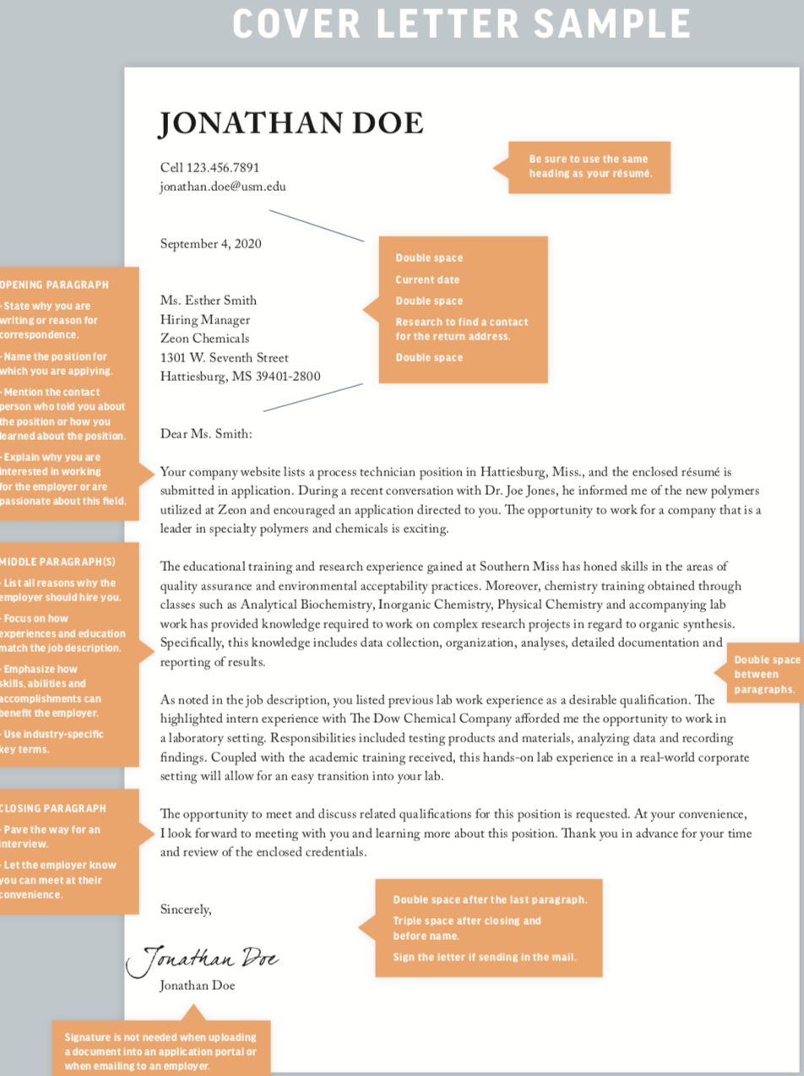
Example
Notes:
Here is an example of a cover letter, and this can be found in the Career Guide. We are going to go through the 5 sections of a cover letter on the next few slides.

Slide 5
Section 1
Notes:
The first section of a cover letter is the header. Like I had mentioned, your cover letter should have the same header as your resume.
Next, you want to include the date two spaces below your header.
Two spaces follow the date, and then you will address your letter to a specific point of contact with the person’s job title and address.
Lastly, you will put two spaces then address the person by typing “dear” followed by the person’s name and a colon. For example, you would write “Dear Ms. Johnson” or Dear Dr. Williams”

Slide 6
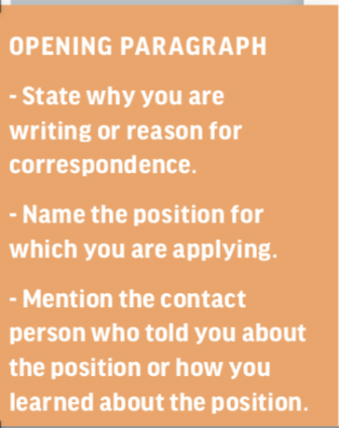
Section 2
Notes:
Section 2 is your opening paragraph. In your opening paragraph, you should state why you’re writing the employer, name the position you’re applying for, state how you learned about the position, and explain why you are interested in working for the employer or in that field.

Slide 7
Section 3
Notes:
Section 3 is the body paragraph or paragraphs, and the overall reasoning for these paragraphs is to explain why the employer should hire you over other candidates.
You should elaborate on your experiences you have had that relate to the job, specific skills you possess, and accomplishments you have that will afford you success in the position.

Slide 8
Section 4
Notes:
Section 4 is the closing paragraph.
In this paragraph, you will mention your openness for an interview, and let the employer know you can meet at their convenience.
Next, you will include a phone number and email address that the employer could reach you at.
Lastly, you will thank the employer for their time.

Slide 9
Section 5
Notes:
Section 5 is your signature.
Your signature can be typed or scripted whether you are emailing the letter or sending it through the mail. Physically signing your letter adds a personal touch to it.

Slide 10
Tips & Tricks
No new information
Upbeat & confident
No plagiarism
No doubt words
“hope,” “think,” “feel”, “believe”
Keep personal pronouns to a minimum
“I,” “me”, “my”
Proofread
Print on résumé paper
Notes:
Here are some tips and tricks to think about when writing your cover letter!
1st. Your cover letter should not include any new information that is not stated somewhere on your resume since your cover letter is used to elaborate on your resume.
2nd. Your cover letter should be written in an upbeat and confident manner.
3rd. You should not plagiarize on your cover letter. Everything should be in your own words and should come from your own thoughts and experiences.
4th. You should not use doubt words like hope, think, feel, or believe because this takes some of that confidence away from what you are writing.
5th. You should keep personal pronouns to a minimum, but that does not mean that you can’t use one every now and then.
6th- always proofread your cover letter. Employers will not hire someone who has multiple spelling and grammar errors in their cover letter. You can use the spellcheck on your computer to help you catch errors that may be in your letter or you can visit the Writing Center on campus; this is a free resource for students to get some help with grammar and sentence structure or just to have an extra pair of eyes review your materials.
7th. If you are physically mailing your cover letter to the employer, then you should print it on resume paper.

Slide 11
Good Luck!
Notes:
Now, you should be prepared to write your cover letter! If you have any further questions, then you can make an appointment with Career Services so a career counselor can look over your letter and make suggestions on how to improve it if need be.

